Slide 1
What is Blockchain ?

Slide 2
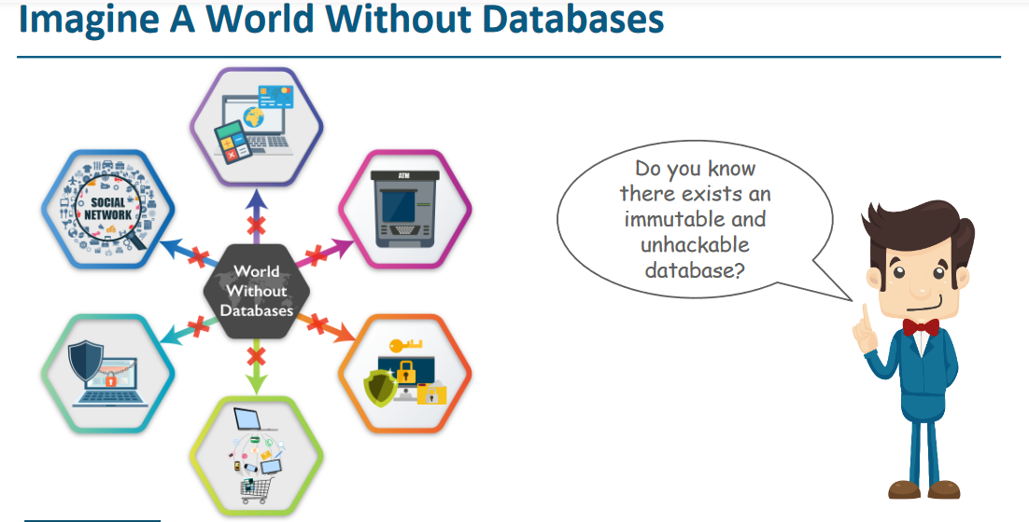

Slide 3
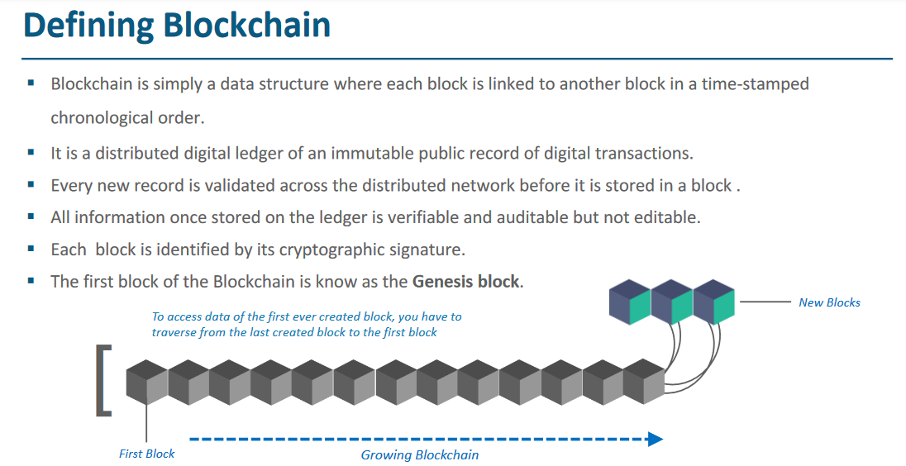

Slide 4
Definition:
Blockchain is a peer-to-peer, distributed ledger that is cryptographically-secure, append-only, immutable (extremely hard to change), and updateable only via consensus or agreement among peers.

Slide 5
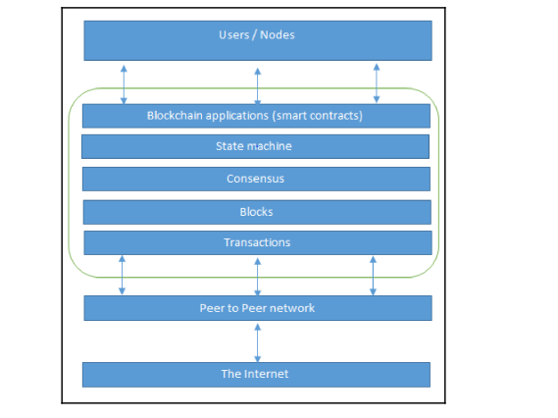
Network view of a Blockchain

Slide 6
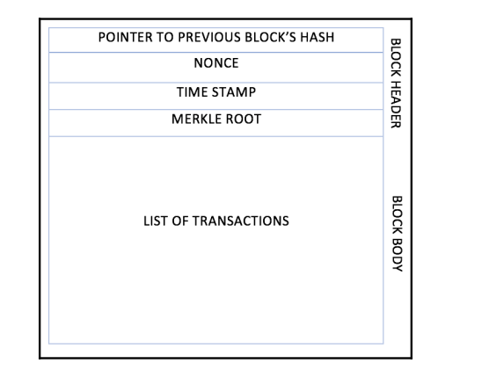
Structure of a Block:

Slide 7
Cryptography Essentials for Blockchain

Slide 8
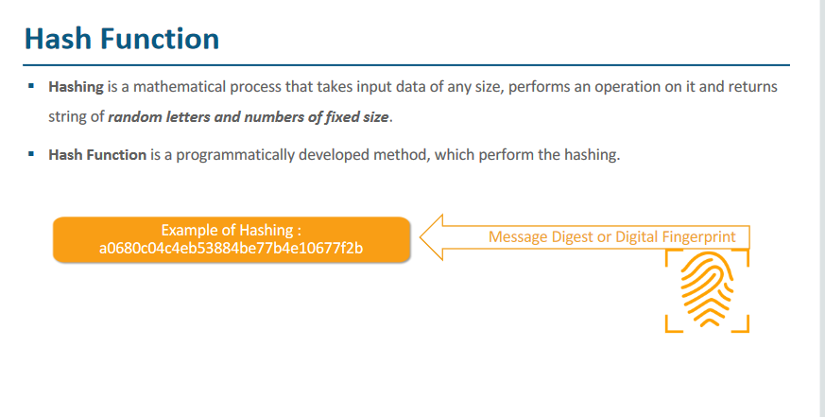

Slide 9
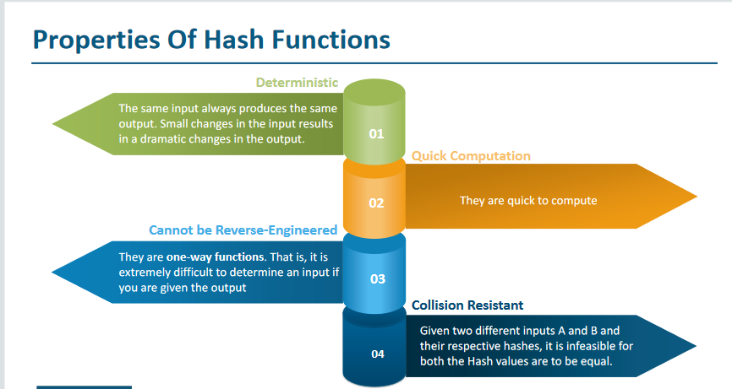

Slide 10
185f8db32271= hello
185f8db32271fe25f561a6fc938b2e264306ec304eda518007d1764826381969=hello
8d586f8b60df1ad7502b52fc50d2e0b6d0d9b5643875c054d821dfd8e6672bed=hell
753692ec36adb4c794c973945eb2a99c1649703ea6f76bf259abb4fb838e013e=hallo
ae325a44898ab0c9d5d254640a1fc1efab25ea4a2525520bc0b952517240f764=Welcome to blockchain technology course.

Slide 11
2256
00000d10bad64b17a24fdf4ba6bc9402f3379aaaf19bd568f1ad307891b9b947
Sha 256

Slide 12
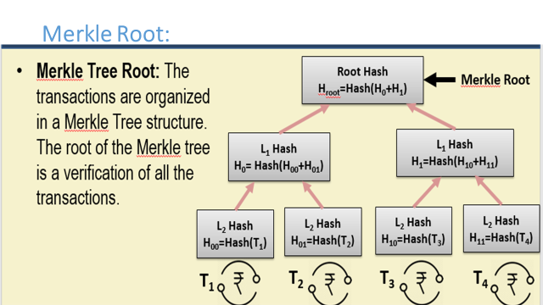

Slide 13
Types of Cryptography
Symmetric Key Cryptography
Asymmetric Key Cryptography

Slide 14
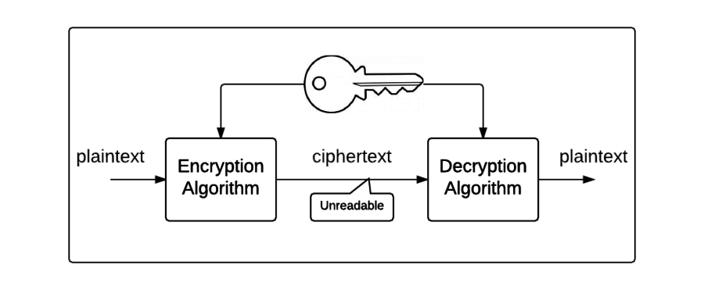
Symmetric Key Cryptography

Slide 15
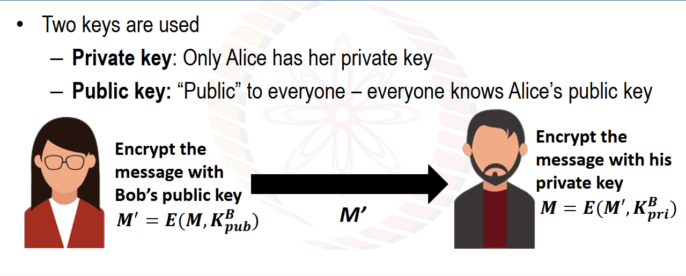
Asymmetric Key Cryptography (Public Key Cryptography)

Slide 16
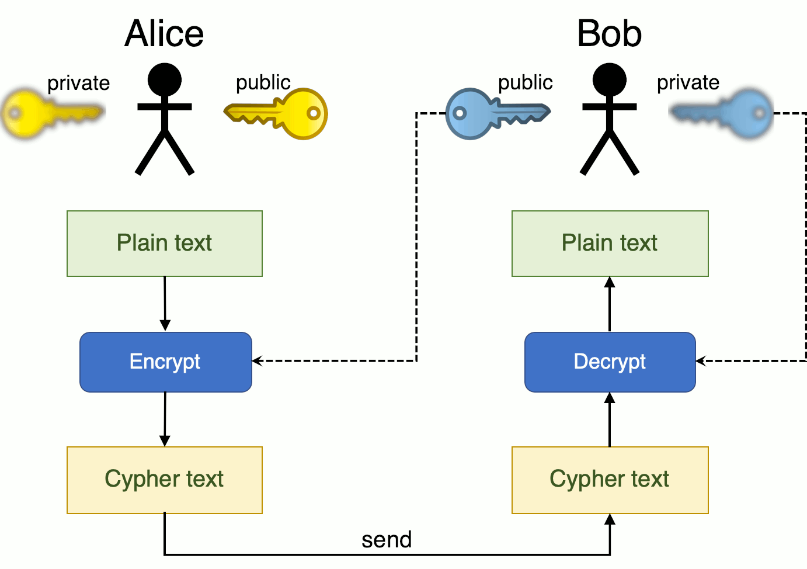

Slide 17
RSA : Used in Bitcoin Blockchain
Diffie – Hellman
Information Security

Slide 18
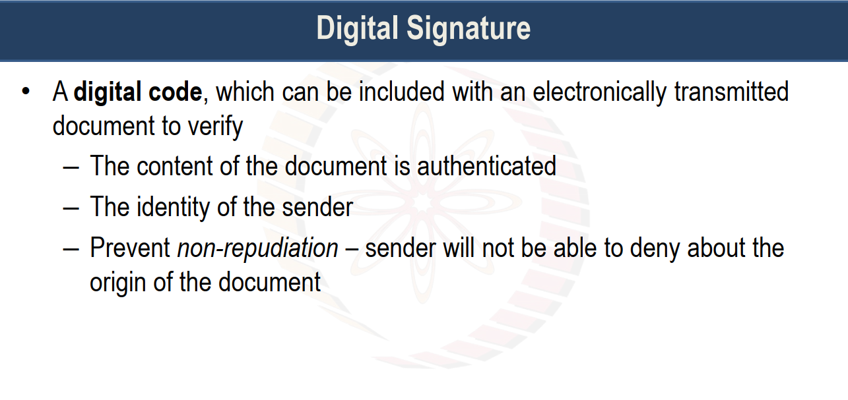

Slide 19
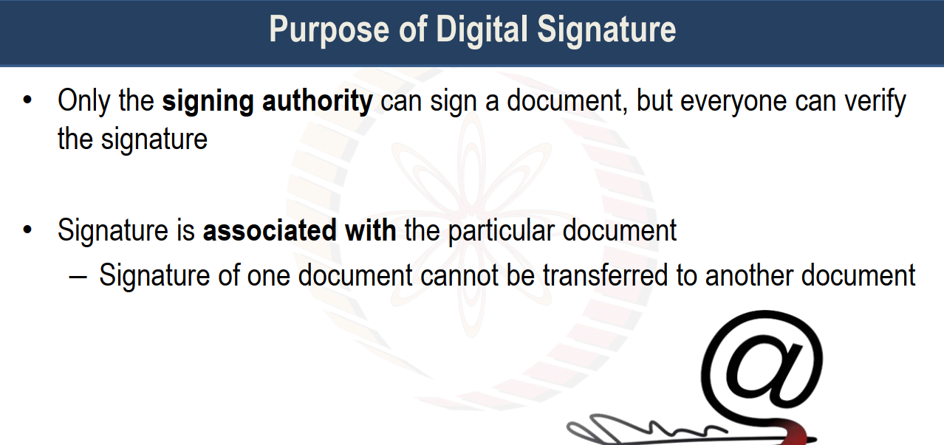

Slide 20
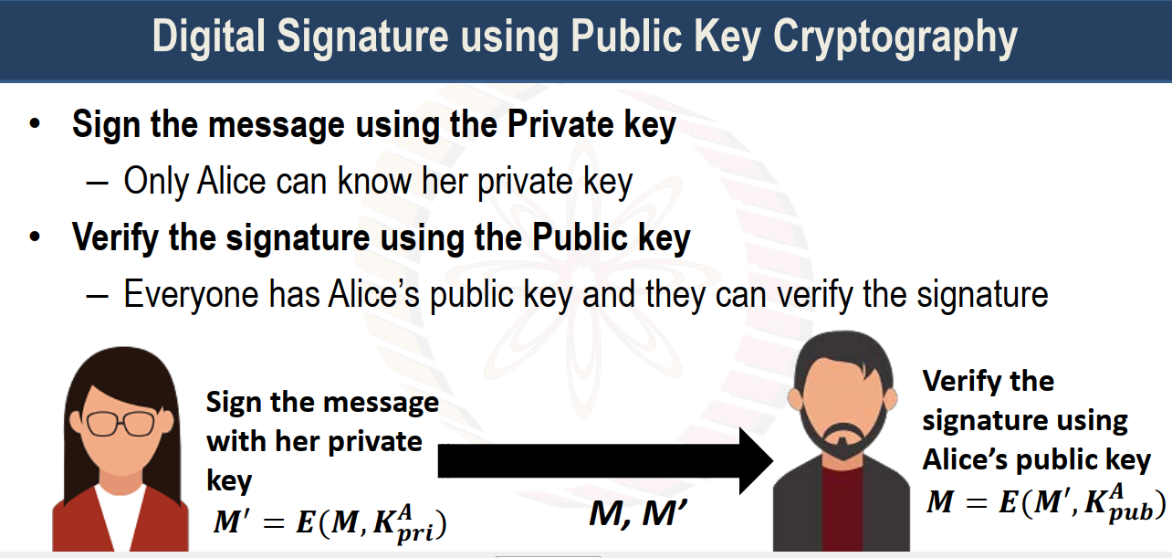

Slide 21
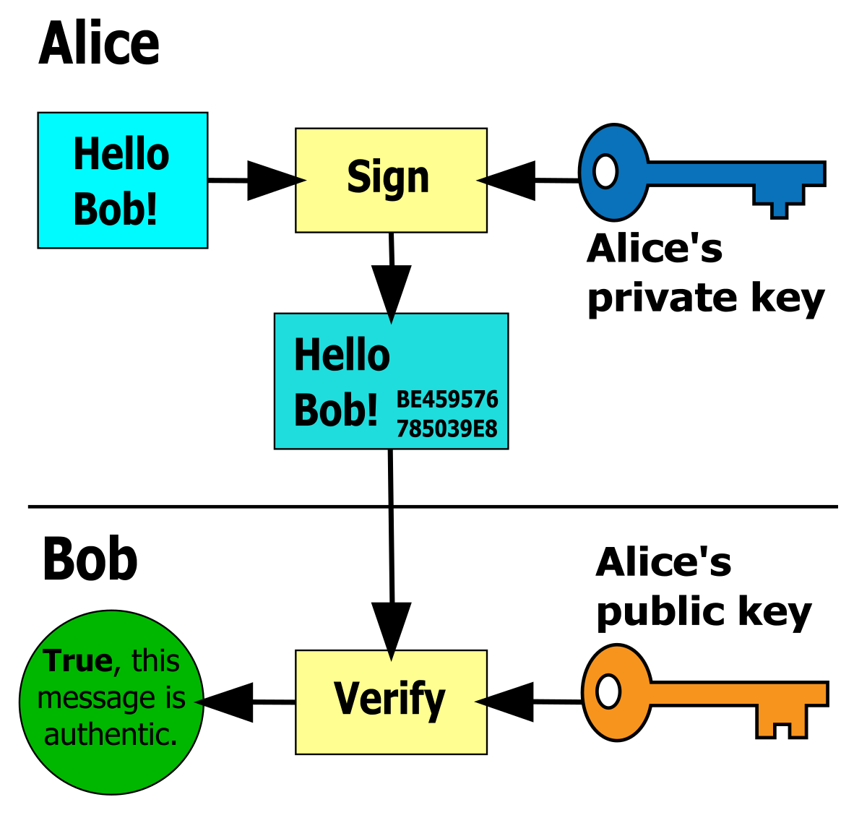

Slide 22
Alice to Bob:
E(E(Msg,Pri_Alice), Pub_Bob)
Bob
D(Msg, Pub_Alice)
D(E(Msg,PriAlice), Pri_Bob)

Slide 23
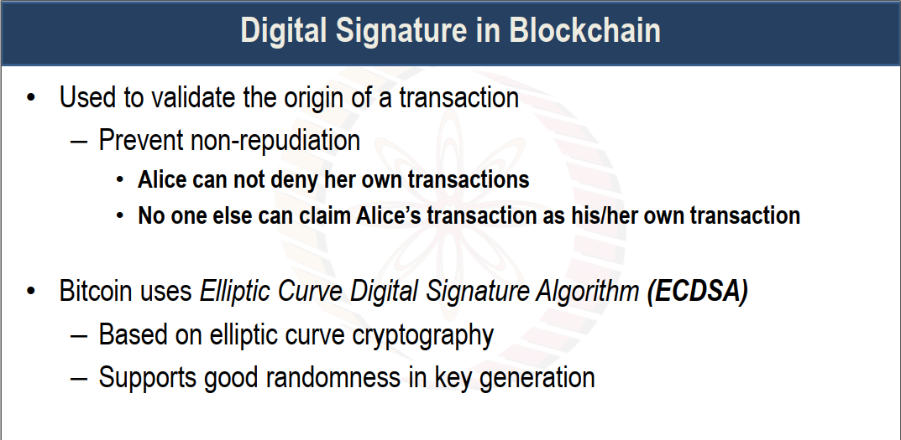

Slide 24
